Slide 1




Capacity Development of EWC Members and Industrial Relations Managers on Green and Digital Transitions
01/10/2023 – 30/09/2025
EWC
Presentation on 30 June 2025
Steering Committee
Project of the Programme for Workers’ Activities (ACTRAV)
Photo credits: weerapatkiatdumrong/iStockphoto.com

Slide 2
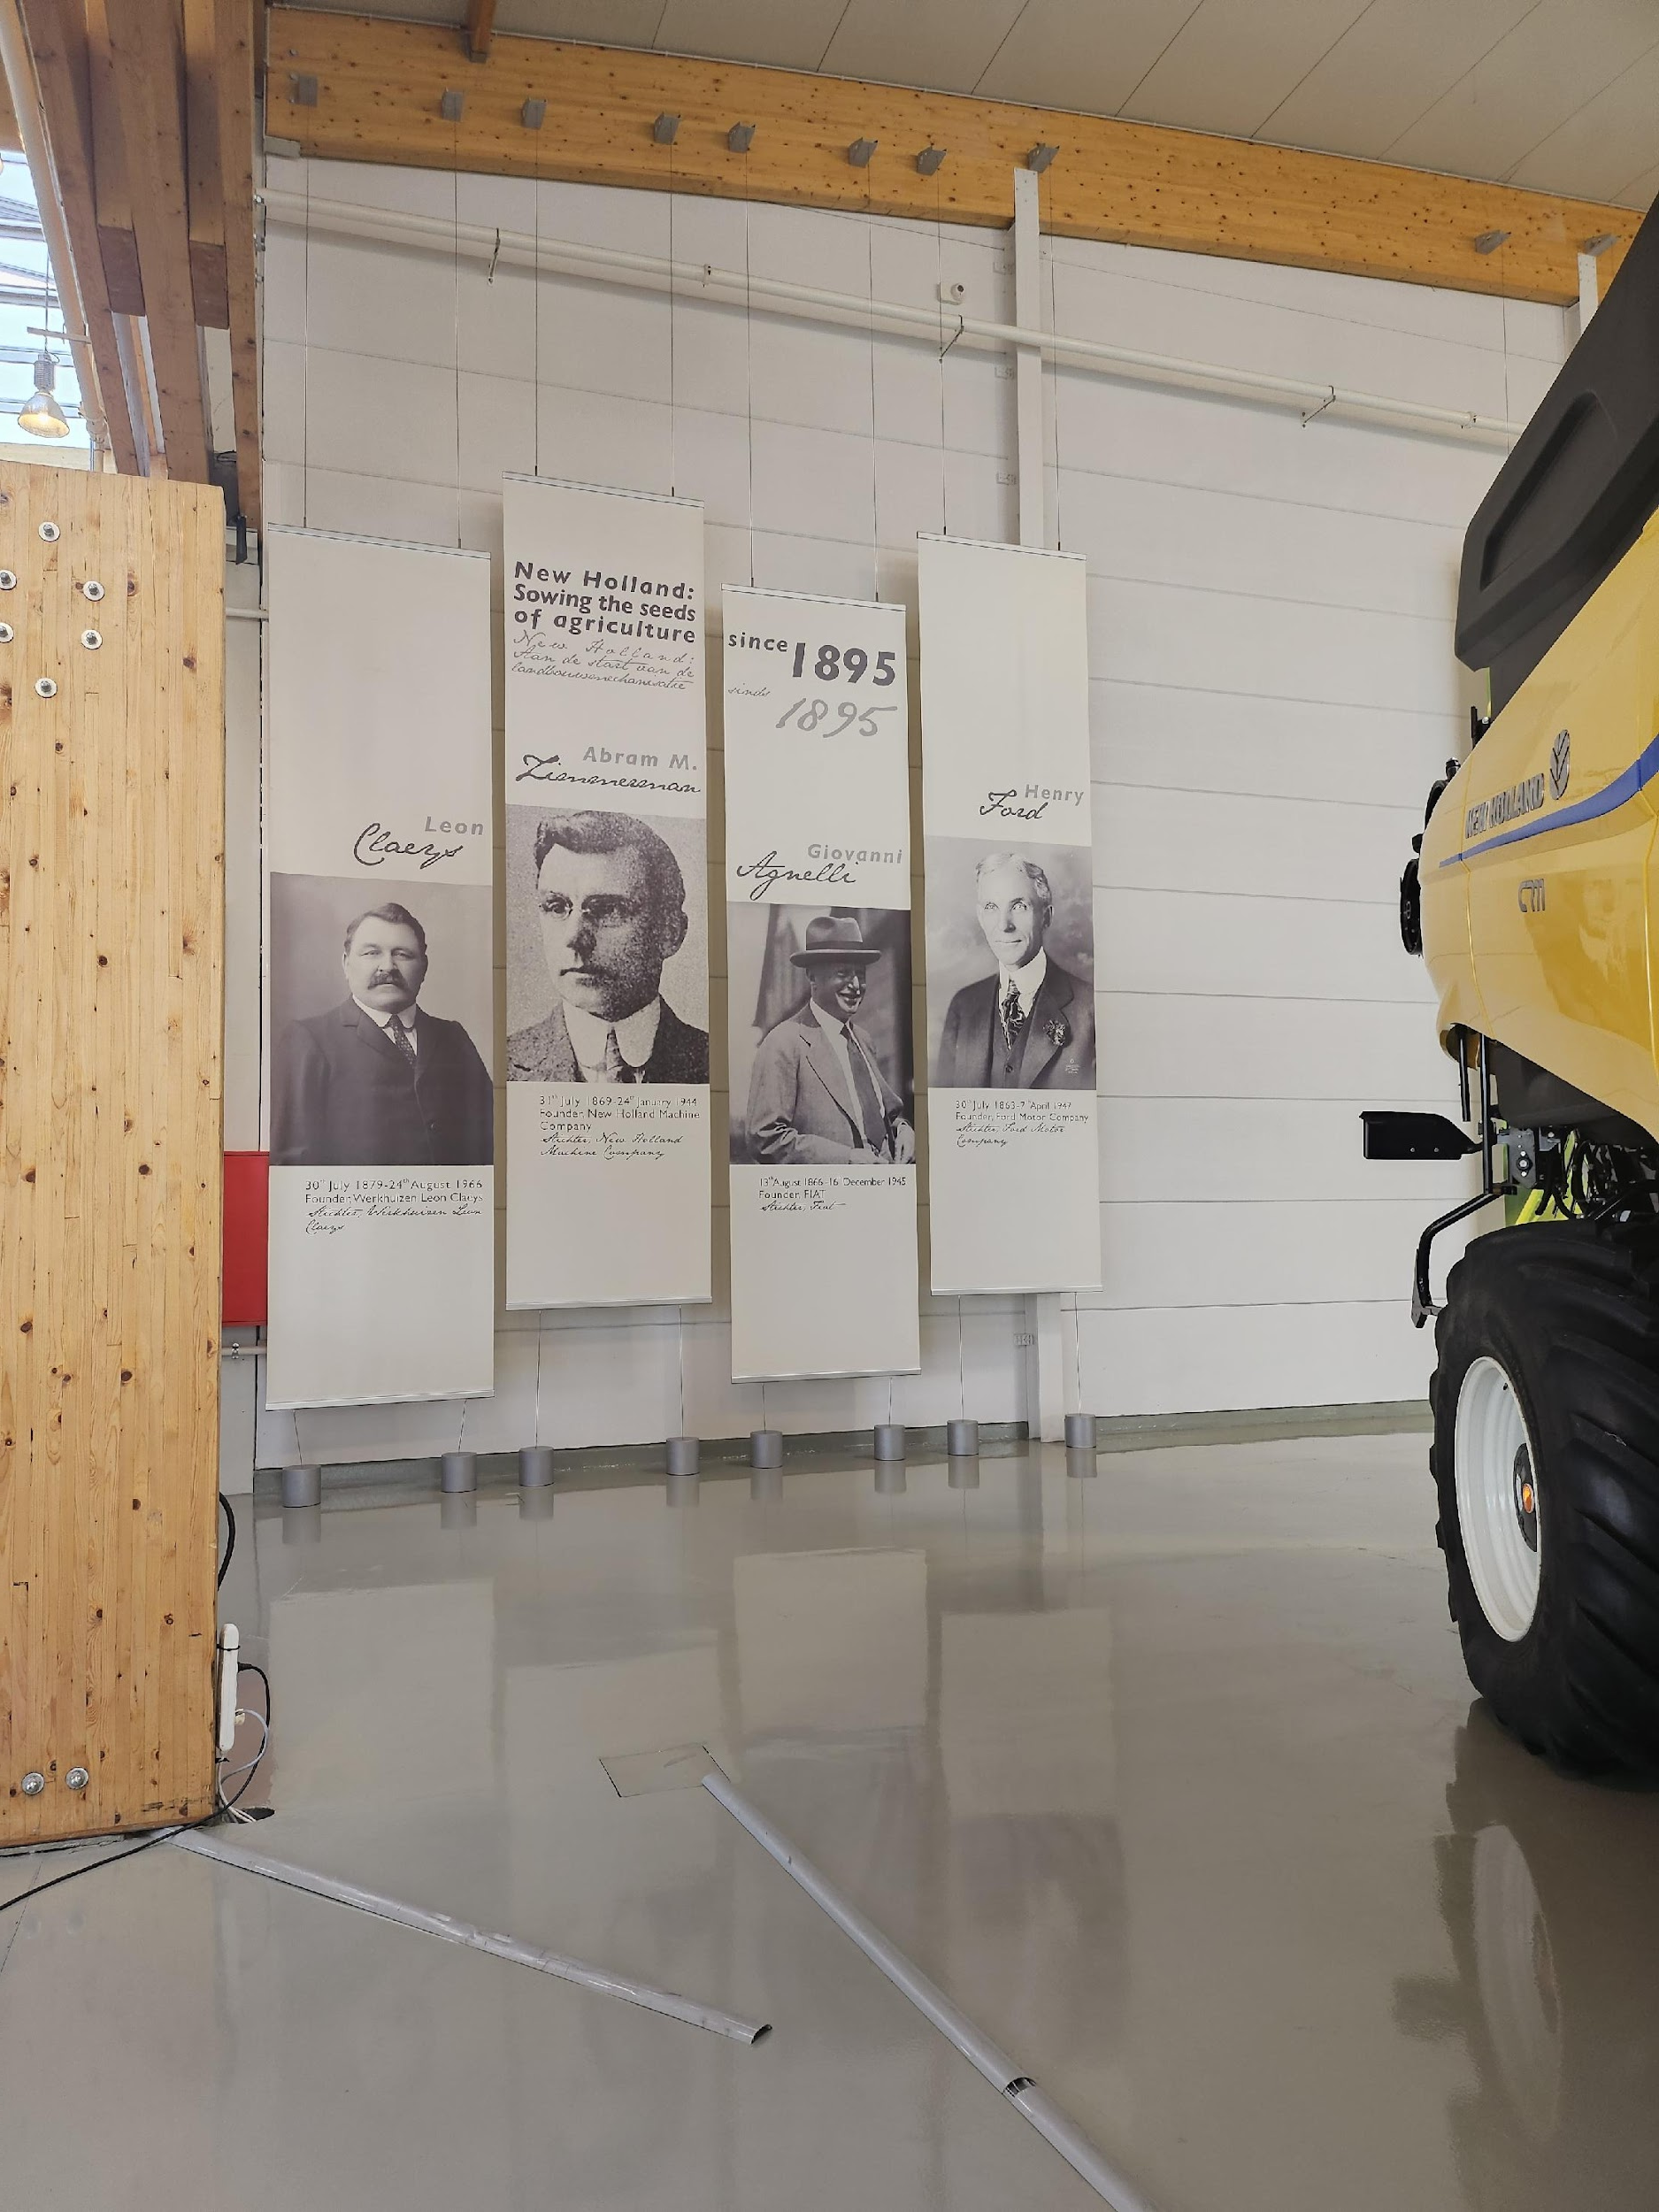
Capacity development
EWC members and industrial relations’ managers on green and digital transitions – a boost to the effectiveness of the European Works’ Council of CNH Industrial
Project of the Programme for Workers’ Activities (ACTRAV)

Slide 3
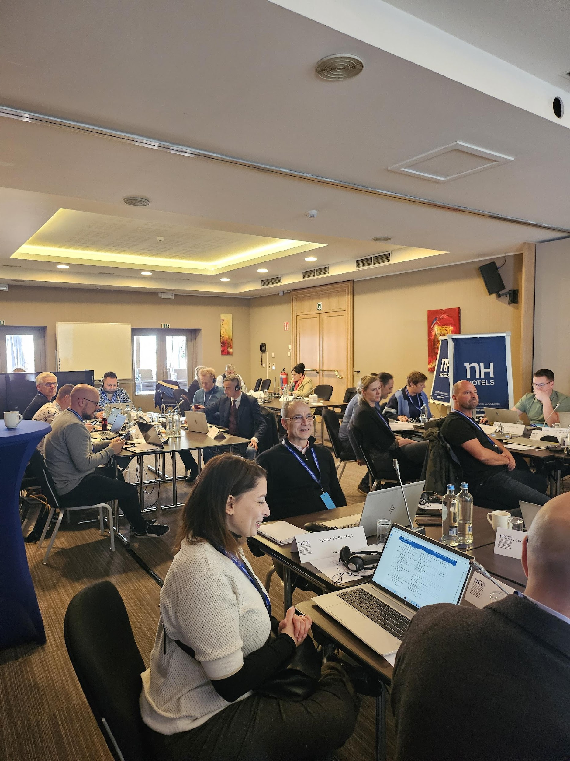
The project contributed to:
i. strengthen CNH Industrial EWC by developing competences of company actors through European Academy based on digital learning and foresight tools;
ii. focus on green and digital transitions in the EU perspective and active exchange of good and innovative practices with peer EWCs operating in EU industry; and
iii. develop and disseminate new tools to support good functioning of the EWCs with great potential for dissemination.
Project of the Programme for Workers’ Activities (ACTRAV)

Slide 4



Preparation
Implementation
Dissemination
Project
timeline
2023
Project launch,
needs assessment & research
2024
Training activities,
materials & tools
2025
Knowledge-sharing,
evaluation, follow-up
Project of the Programme for Workers’ Activities (ACTRAV)

Slide 5
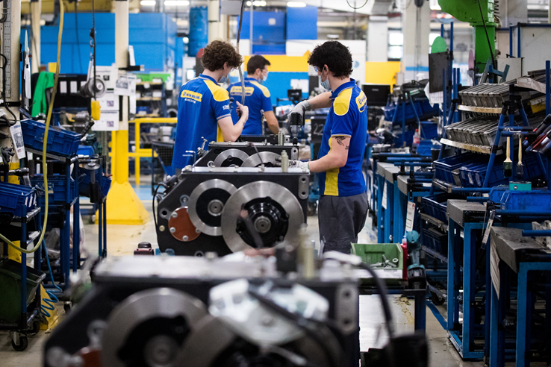
01
Preparation
Project of the Programme for Workers’ Activities (ACTRAV)

Slide 6
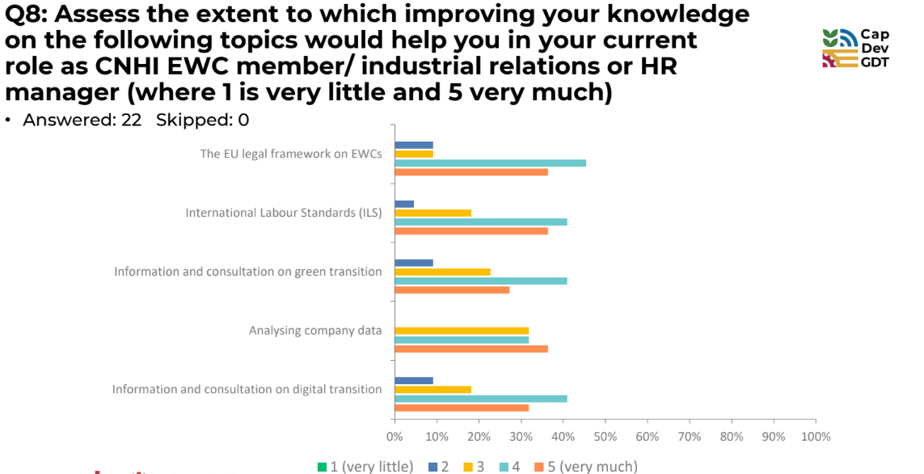
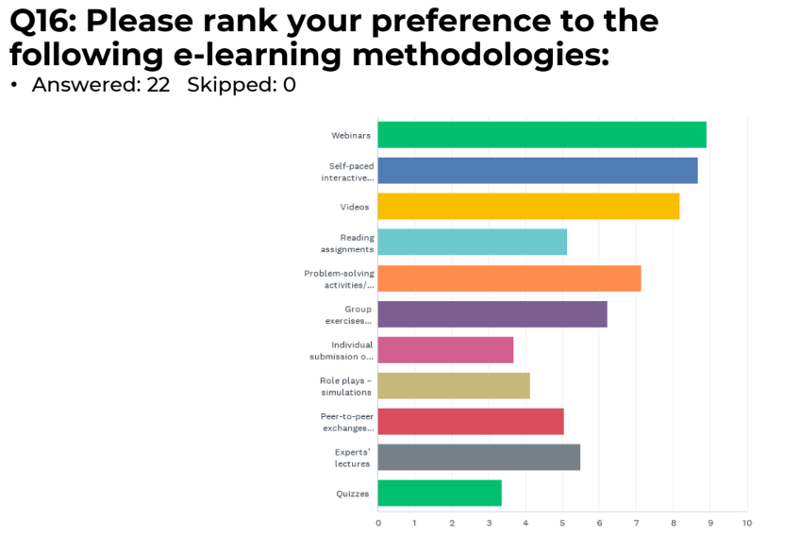
Preparatory phase 2023/24
Kick-off Webinar
Project has been launched
6 December 2023
Learning-needs Survey
Participants’ needs in digital learning
February 2024
Project of the Programme for Workers’ Activities (ACTRAV)

Slide 7
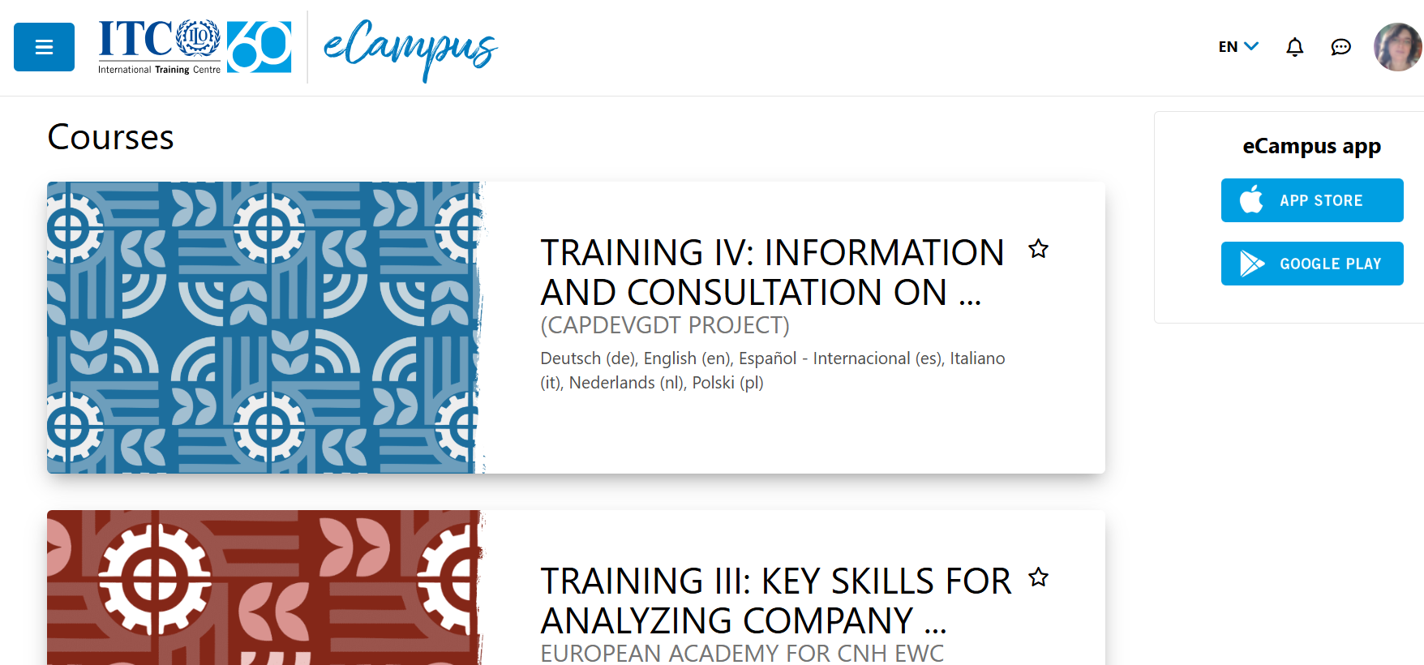
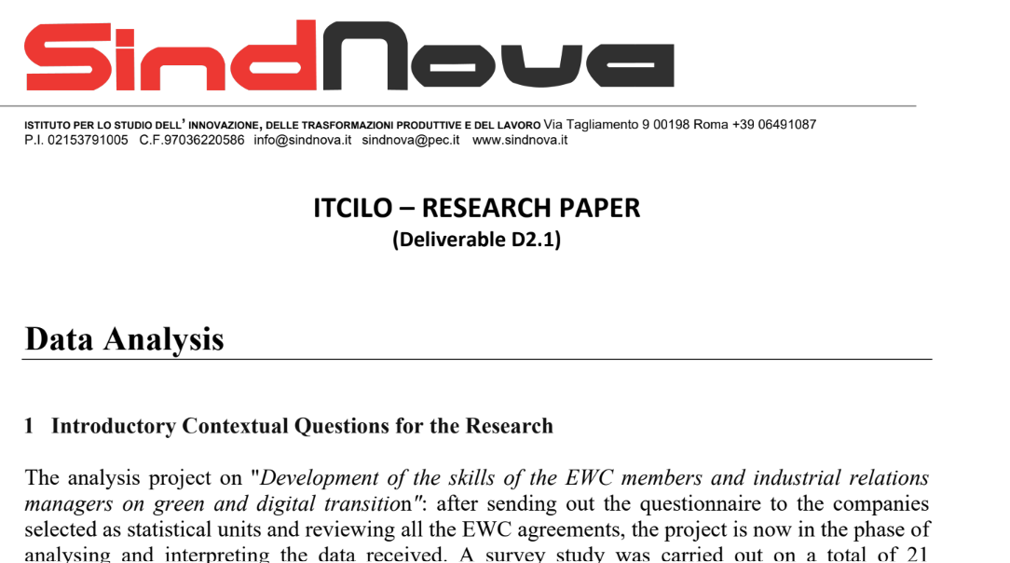
Preparatory phase 2023/24
E-campus
Online platform for learning
Research Paper
Desk research resulting in identification of case studies and good practices
Sindnova
Project of the Programme for Workers’ Activities (ACTRAV)

Slide 8
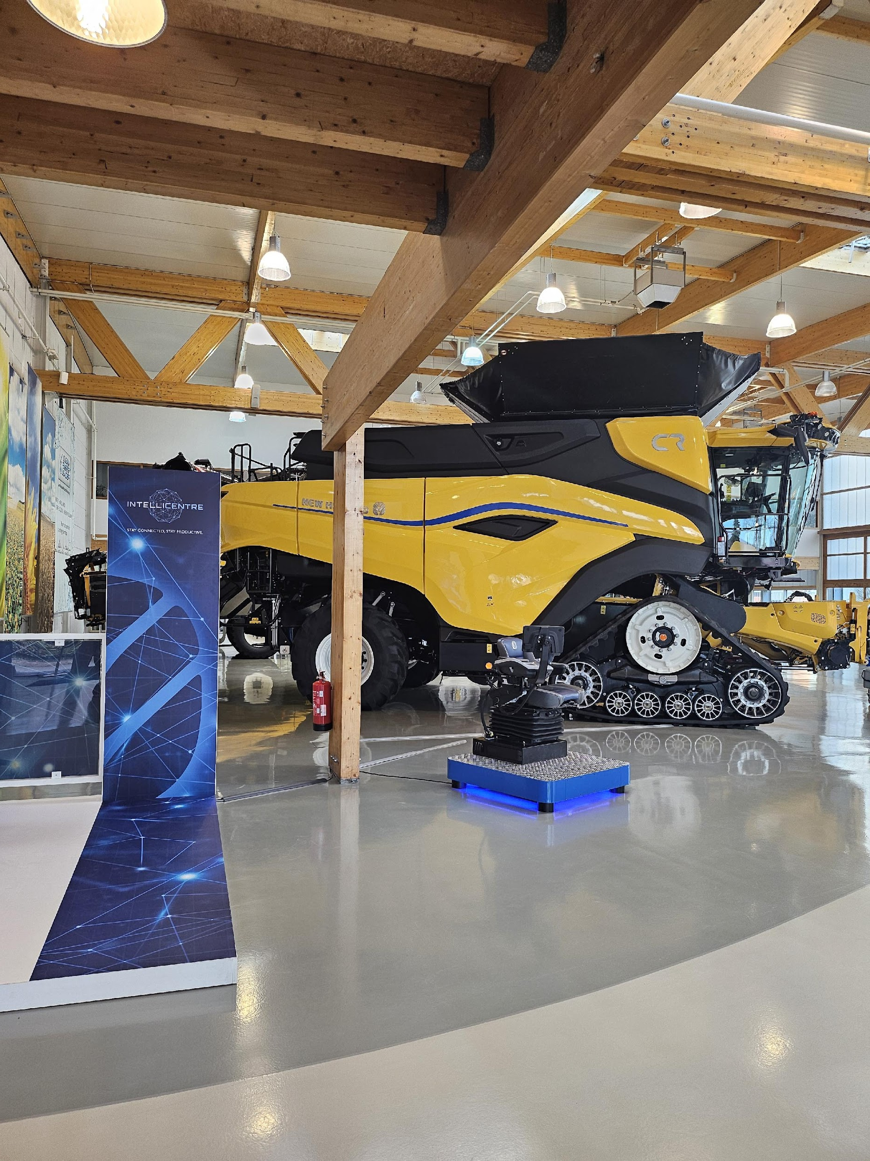
02
Implementation

Slide 9
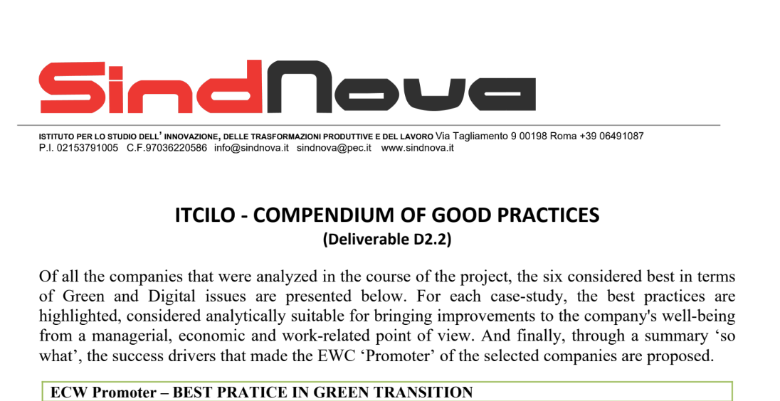
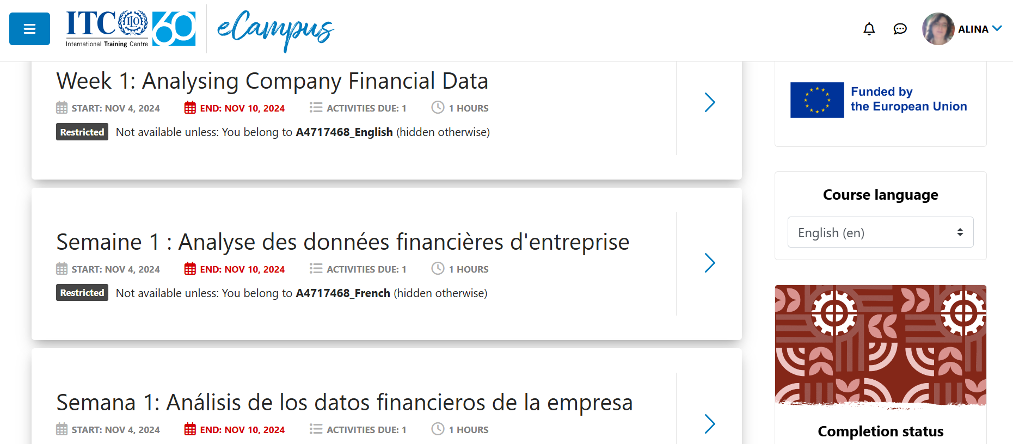
Implementation phase 2024
European Academy
Implementation of training activities I, II & III
EU legal framework on EWCs
Green transition
Analysing company data
Research Paper and Compendium
of good practices is finalized and available

Slide 10
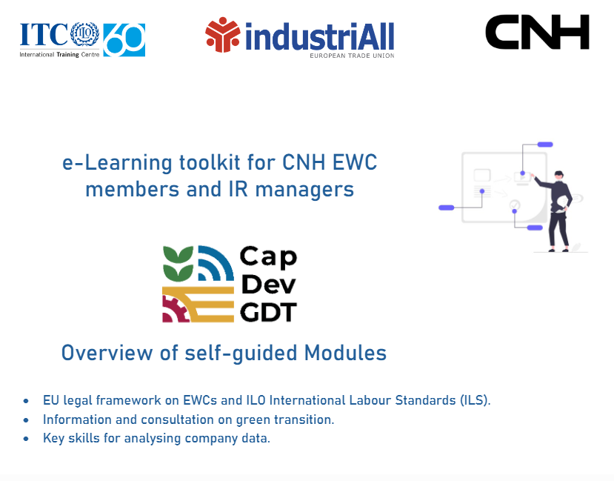
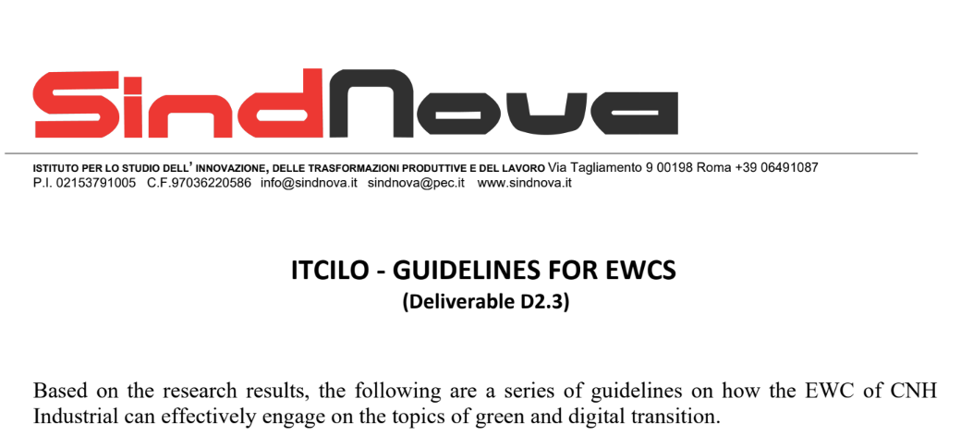
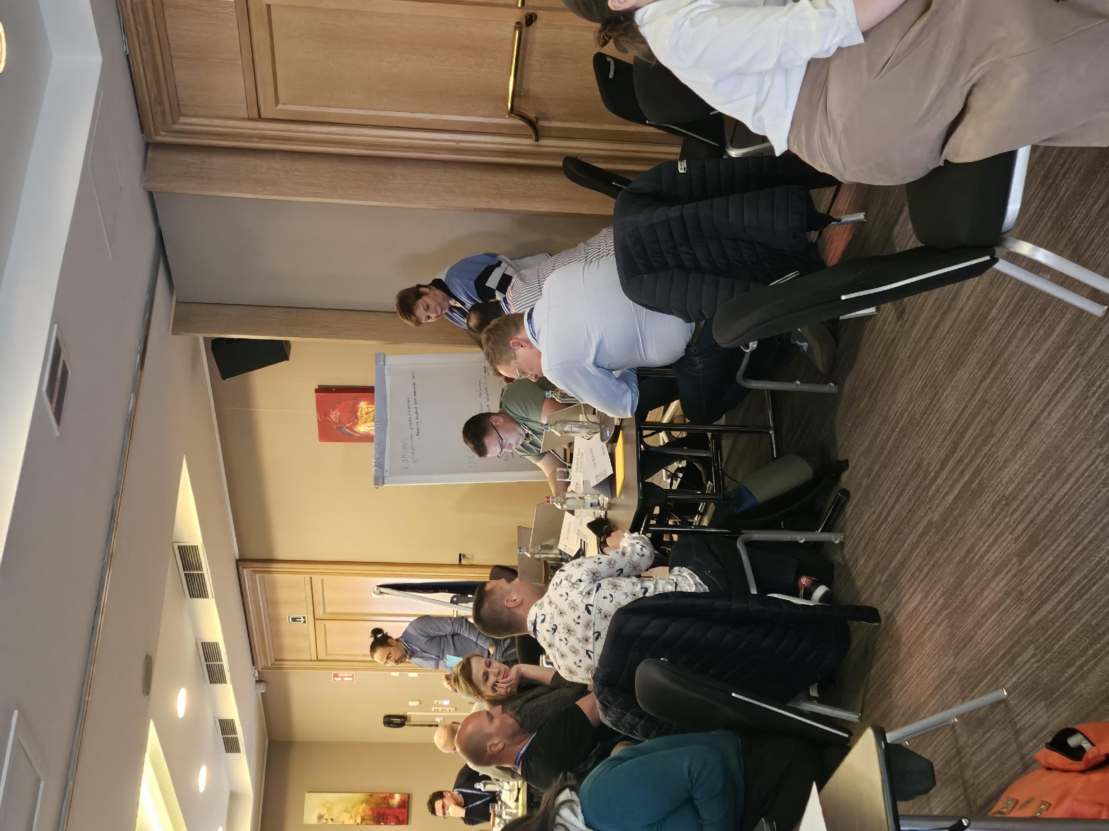
Implementation phase 2024-2025
Training IV
Implementation of training activity on digital transition
Guidelines
E-Learning Toolkit
EU legal framework on EWCs
Green transition
Analysing company data
Digital transition
For EWCs on engaging with green and digital transitions are drafted

Slide 11
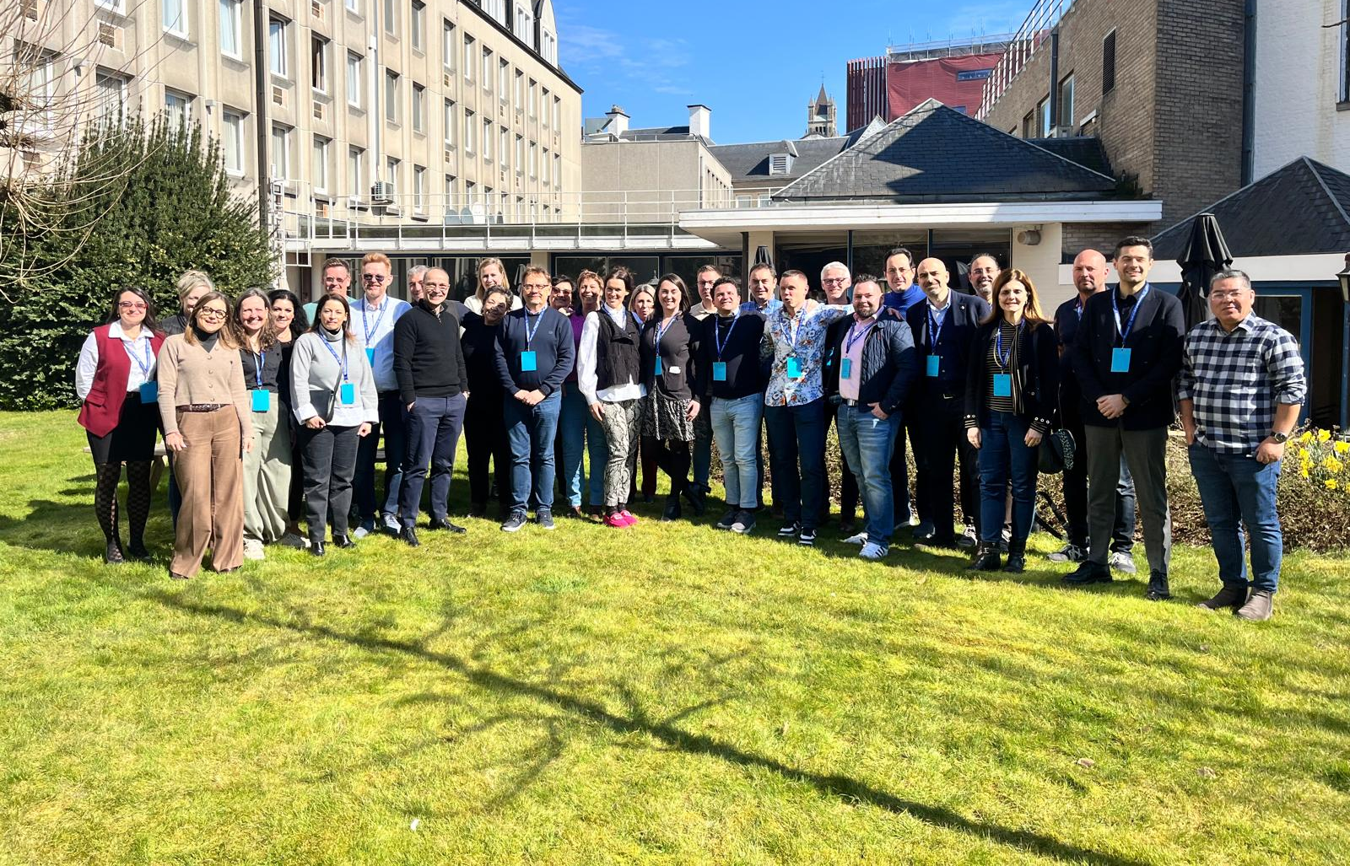
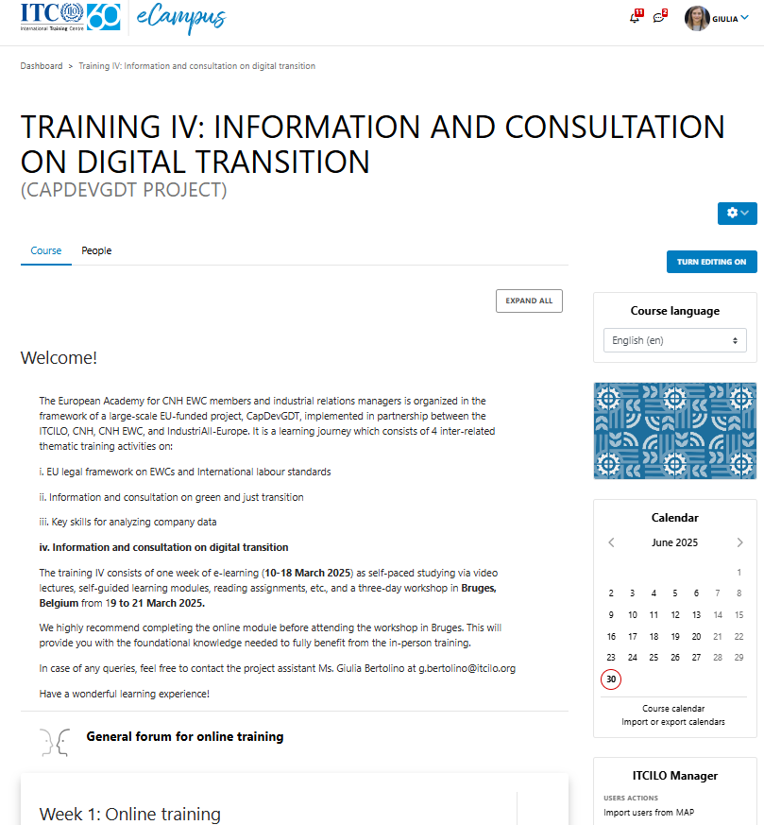
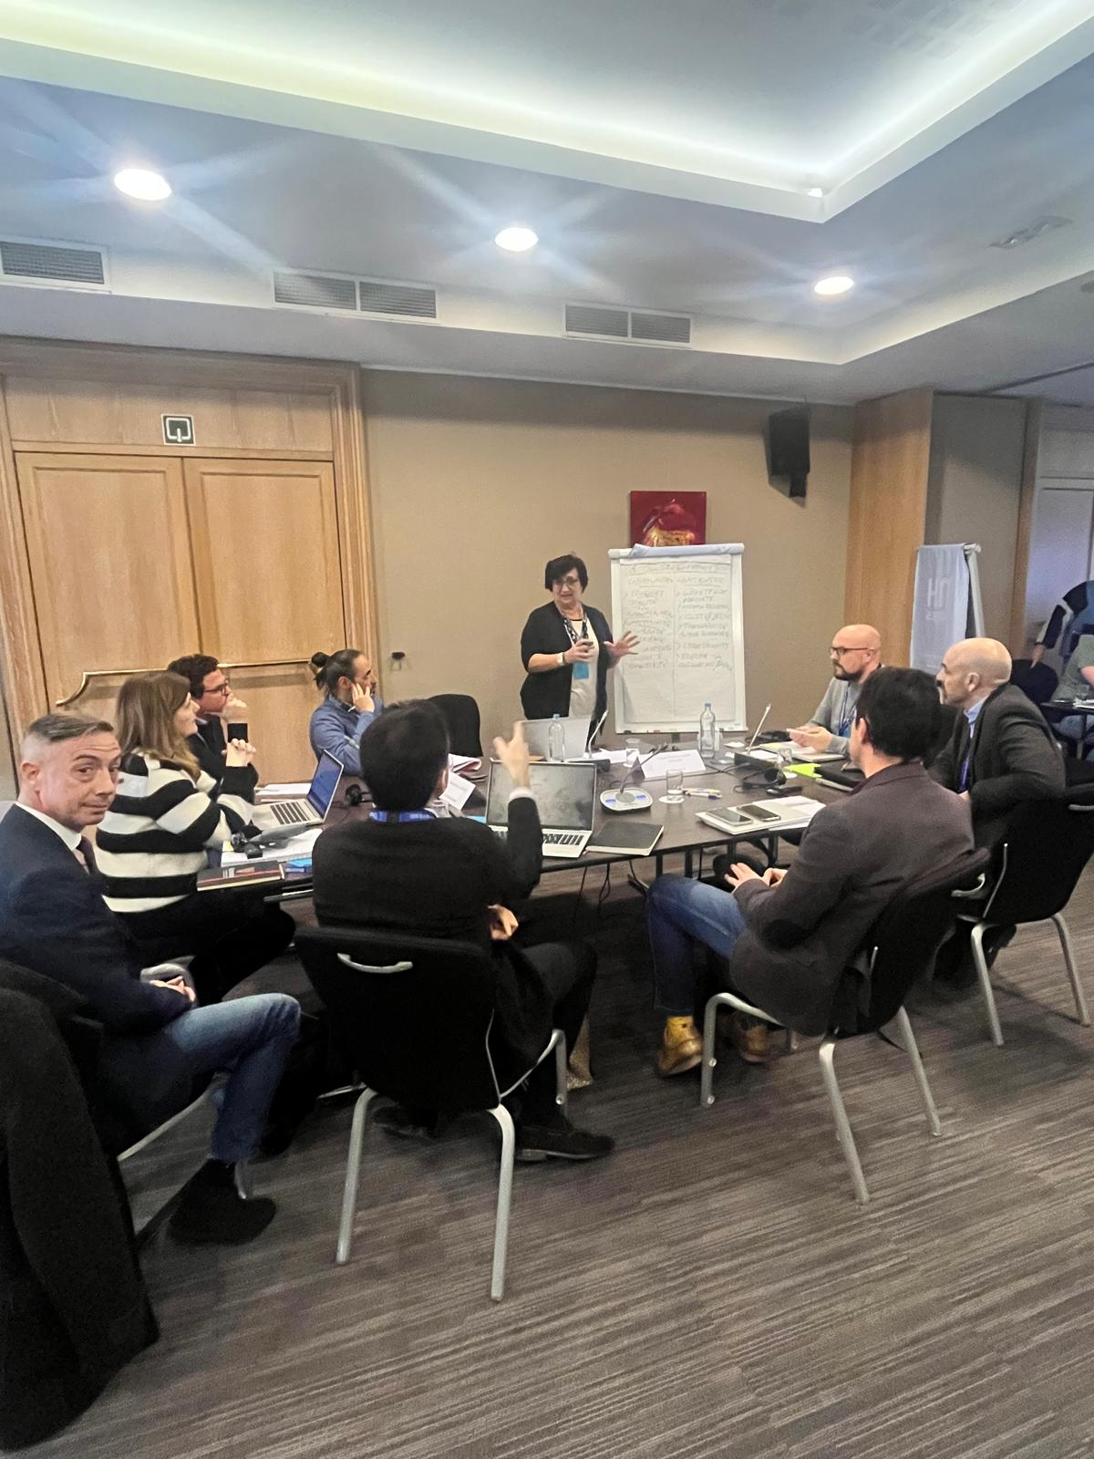
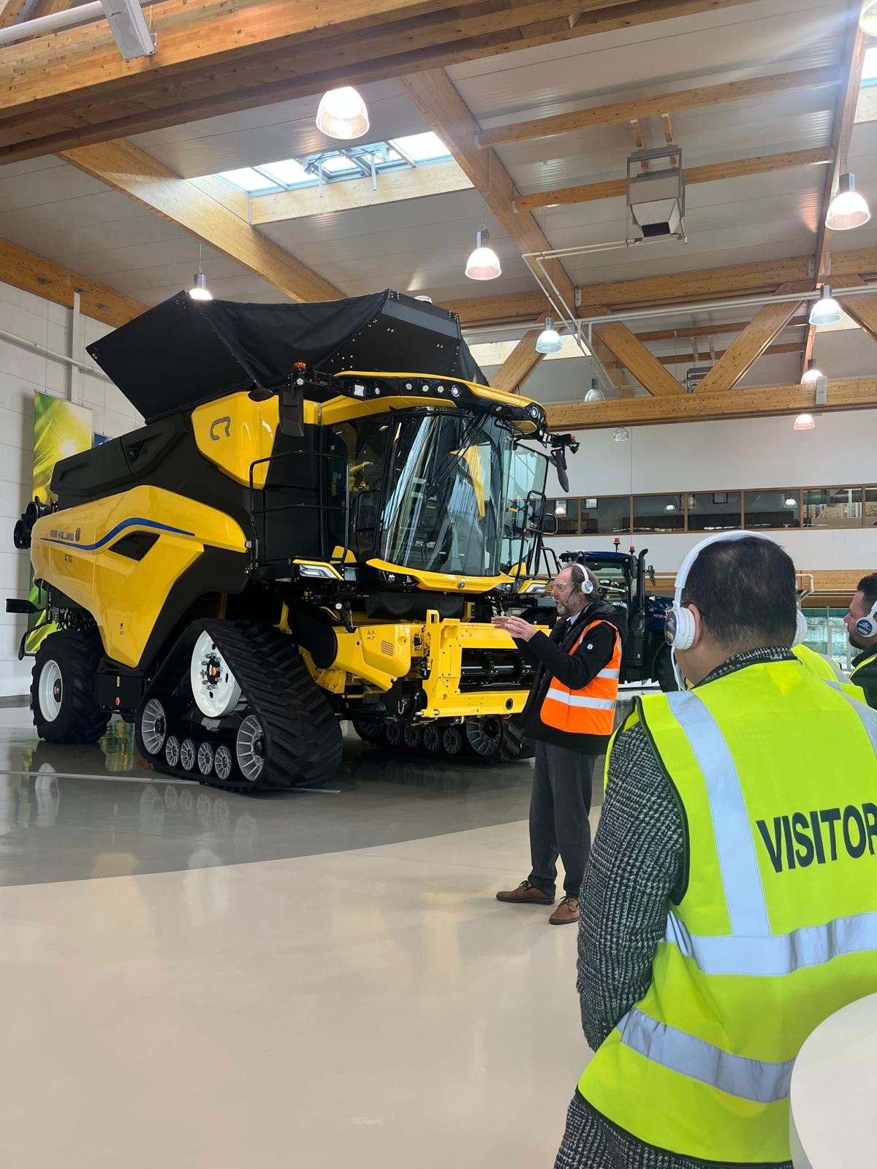
What we have achieved…
Programme for Workers’ Activities
We have successfully implemented
TRAINING IV: INFORMATION AND CONSULTATION
ON DIGITAL TRANSITION
Online (eCampus) + F2F workshop (Bruges, Belgium)

Slide 12
What we have achieved…
Programme for Workers’ Activities
We have completed the EUROPEAN ACADEMY ON INFORMATION AND CONSULTATION ON GREEN AND DIGITAL TRANSITIONS FOR CNH EWC MEMBER AND IR AND HR MANAGERS
TRAINING 2
Green transition
TRAINING 1
EU legal framework on EWCs
TRAINING 3
Analysing
company data
TRAINING 4
Digital transition
09 – 20 September 2024
Delivery: Blended
Live webinars and self-guided e-learning modules on the eCampus
Face-to-face training in Modena
Arrival: 17 September
Departure:
20 September
Incl. Study visit to plant
4 – 15 November 2024
Delivery: online
Live webinars and self-guided e-learning modules on the eCampus
19 – 21 March 2025
Delivery: Self-guided e-learning modules on the eCampus
Face-to-face training in Bruges
Arrival: 18 March
Departure:
21 March
Incl. Study visit to plant
11 – 22 March 2024
Delivery: online
Live webinars and self-guided e-learning modules
on the eCampus

Slide 13
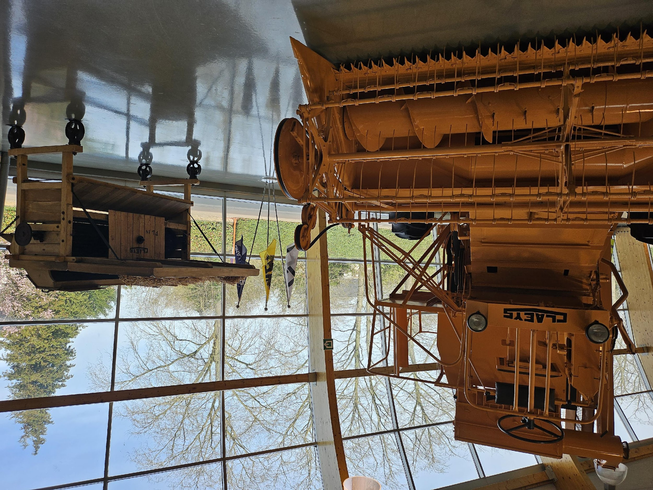
03
Dissemination

Slide 14


Dissemination & Application 2025
TO RECAP…
Evaluation
Steering III
Action Plans
Lessons learned & follow-up
Practical application –
ways to practically apply the Guidelines
Impact evaluation survey
Evaluation interviews
SEPTEMBER 2025
AUTUMN 2025
PROJECT END DATE:
30 SEPTEMBER 2025
Dissemination Conference
Reporting
Final technical & financial report
Best practices of information and consultation on twin transitions (peer-to-peer)

Slide 15
Dissemination conference
Programme for Workers’ Activities
Next steps …
The event will be held at the ITCILO Campus in Turin, Italy.
Dates: 2-3 September 2025
It will be delivered in hybrid format (F2F + online participation)
Topics:
CapDevGDT project review: insights of activities carried on, results achieved, materials produced
Workers’ participation in twin transitions: engaging panel of discussions revealing significant contributions of social partners for a just future
Cross-cutting themes in information and consultation on green and digital transitions: sharing of best practices in implementing the green and digital agenda in the EU space and beyond
Green and digital transition in companies: an opportunity to connect companies from various sectors of activity, driving twin transition processes

Slide 16
04
Project Deliverables

Slide 17

Project deliverables
02
E-learning toolkit
01
Capacities
04
Guidelines for EWCs
03
Good practices
For CNH Industrial EWC members is developed and distributed
In the areas of EU law on EWCs, analysing company data and green and digital transitions are increased
on engaging with green and digital transitions are developed and disseminated
Identified in Research Paper & Compendium are applied

Slide 18

Thank you

